Slide 1

SREE DATTHA INSTITUTE OF ENGINEERING AND SCIENCE
(UGC - Autonomous)
Sheriguda (V), Ibrahimpatnam (M), Telangana - 501510.
www.sreedattha.ac.in
Department of Computer Science and Engineering
TITLE OF THE PROJECT: CLOUD ASSISTED FAST ROUTE DISCOVERY
IN AODV FOR DISASTER CLUSTER STABILITY
Batch No:03
1. M.Ankitha 23E41A05J5
2.G.Vindhu 23E41A05L0
3. G.Akhil Kumar 23E41A05L6
4. N.BalajiJyoshika 23E41A05K1
Under the Guidance of
P.Anupama
Assisstant Professor
Department of Computer Science and Engineering

Slide 2
OUTLINE
Title of the project
Abstract
Introduction
Literature Survey
Existing System
Proposed System
Module Split-up

Slide 3
8. Progress on Design
9. Analysis and Experimental Work
10. Prototype
11. Result and Analysis
12. Conclusion

Slide 4
Cloud Assisted Fast Route Discovery in AODV For Disaster Rescue Cluster Stability
Cloud-assisted fast route discovery in AODV enhances communication reliability in disaster cluster environments by leveraging cloud computing support.
During disasters, network nodes are highly mobile and infrastructure is unstable, causing frequent route failures.
The cloud assists by maintaining updated network state information and predicting optimal routes.

Slide 5
ABSTRACT
In disaster rescue environments, conventional communication infrastructure often fails, necessitating the use of Mobile Ad Hoc Networks (MANETs) for emergency coordination. Although the Ad hoc On-Demand Distance Vector (AODV) protocol is widely used due to its on-demand routing capability, it suffers from slow route discovery, frequent link failures, and unstable clustering under high node mobility. These issues result in increased end-to-end delay, packet loss, and routing overhead To address these limitations, this project proposes a Cloud Assisted Fast Route Discovery mechanism integrated with AODV.

Slide 6
INTRODUCTION
.
During natural disasters such as earthquakes, floods, and cyclones, communication systems like mobile networks often fail.
This happens due to damaged towers, power failures, and network congestion.
Because of this, rescue teams cannot communicate properly.
They sometimes depend on paper records or verbal messages, which are slow and can cause errors.

Slide 7
INTRODUCTION
Manual System: Uses paper records and verbal messages; slow, error-prone, and unsuitable for real-time disaster response.
Infrastructure-Based Cellular System: Relies on cell towers and base stations; infrastructure damage causes network failure during disasters.
Relay-Based Communication System:Messages are passed through intermidate nodes or people one by one until it reaches the destination.
Routing algorithms like AODV and DSDV overcome the limitations of traditional systems by enabling efficient , reliable.

Slide 8
LITERATURE SURVEY
[1] Zhao Y. Research on multi hop transmission optimization technology in mobile Ad Hoc networks [D]. Electronic Science Research Institute of China Electronics Technology Corporation, 2022.
[2] Zhu X. Research on routing algorithm of wireless Ad Hoc networks in disaster rescue scenarios [D]. Chongqing University of Posts and Telecommunications, 2018.
[3] An J. Research on Improvement of Low overhead AODV Routing Algorithm in Mobile Ad Hoc Networks[D]. Tianjin University of Technology, 2017.
[4]S. Misra, S. Chatterjee, and M. S. Obaidat, “On Theoretical Modeling of Cloud-Assisted Routing in Mobile Ad Hoc Networks,” IEEE Systems Journal, vol. 10, no. 2, pp. 706–717, June 2016.
[5]A. Boukerche, B. Turgut, N. Aydin, M. Z. Ahmad, L. Bölöni, and D. Turgut, “Routing protocols in ad hoc networks: A survey,” Computer Networks, vol. 55, no. 13, pp. 3032–3080, Sept. 2011.

Slide 9
[6] S. K. Dhurandher, M. S. Obaidat, and I. Woungang, “Cluster-Based Routing Protocols for Disaster Recovery Networks,” International Journal of Communication Systems, vol. 27, no. 12, pp. 3919–3942, Dec. 2014.
[7] J. Lloret, M. Garcia, D. Bri, and S. Sendra, “A Wireless Sensor Network Deployment for Rural and Forest Fire Detection and Verification,” Sensors, vol. 9, no. 11, pp. 8722–8747, Nov. 2009.
[8]Y. Zeng, K. Xiang, D. Li, and A. V. Vasilakos, “Directional Routing and Scheduling for Green Vehicular Networks,” Wireless Networks, vol. 19, no. 2, pp. 161–173, Feb. 2013.
[9]H. Zhou, H. Wang, and X. Li, “Cloud-assisted Emergency Communication System for Disaster Rescue,” IEEE Communications Magazine, vol. 55, no. 8, pp. 70–76, Aug. 2017.
[10]S. K. Sarkar and T. G. Basavaraju, Ad Hoc Mobile Wireless Networks: Principles, Protocols, and Applications, 2nd ed., Boca Raton, FL, USA: CRC Press, 2016.

Slide 10
EXISTING SYSTEM
Traditional disaster communication depends on fixed networks like mobile towers and cables.
During disasters, these networks often get damaged or overloaded.
This causes communication failure at critical times.
The system cannot adjust to changing conditions on its own.

Slide 11
PROPOSED SYSTEM
The proposed system is designed for disaster rescue communication where normal network infrastructure is unavailable.
It uses a Mobile Ad Hoc Network (MANET), where rescue teams act as mobile nodes.
Nodes communicate with each other without using mobile towers or fixed networks.
The system uses the AODV, DSVD routing protocol for communication.

Slide 12
MODULE SPLIT-UP
Network Initialization – Creates the ad hoc network with mobile nodes.
Clustering Module – Groups nodes and selects cluster heads for stability.
AODV Module – Finds routes only when needed to reduce overhead.
DSDV Module – Uses routing tables and periodic updates for comparison.
Performance Module – Measures delivery rate, hop count, and load.
Visualization Module – Stores data and shows results on a web interface.

Slide 13
PROGRESS ON DESIGN
Problem Analysis
Initially, the limitations of traditional disaster communication systems and standard AODV routing were analyzed.
Key issues identified include slow route discovery, frequent link failures, and unstable clustering in highly dynamic MANET environments.

Slide 14
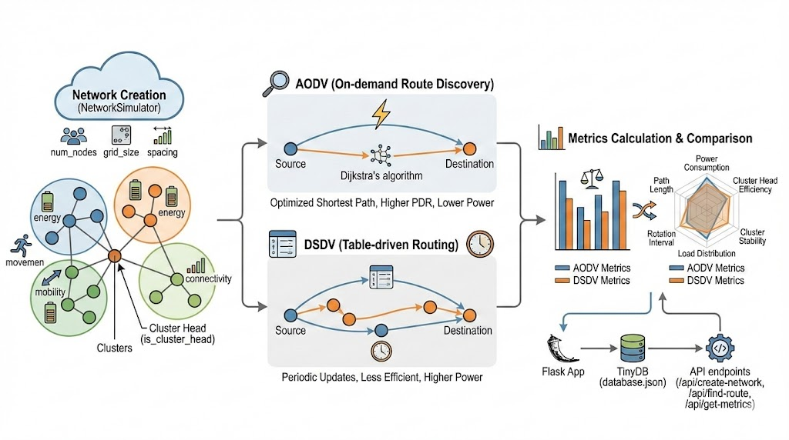
2. System Architecture Design
A cloud-assisted MANET architecture was designed where mobile nodes form an ad hoc network while a cloud layer provides global support.
The architecture consists of:Mobile rescue nodes (MANET layer)Cloud server for route intelligence Communication interface between nodes and cloud. This layered design enables faster and more reliable routing.

Slide 15
3. Routing Algorithm Design
The standard AODV protocol was modified to integrate cloud-assisted route discovery. The design includes:
Faster route request handling
Reduced broadcast flooding
Cloud-supported route optimization
Improved route maintenance and recovery.
A comparison with DSDV was also considered for performance evaluation.

Slide 16
4.Cluster Stability Model
A mechanism was designed to maintain stable clusters by:
Selecting reliable nodes as cluster heads
Minimizing frequent topology changes
Maintaining stable communication groups
This improves coordination among rescue nodes.

Slide 17
5. Current Status
The overall system design, routing logic, and architecture have been completed.
The project is now moving towards Software implementation and performance evaluation.
We will implement the cloud-assisted AODV model using simulation tools and evaluate its performance by comparing it with traditional routing protocols.

Slide 18
ANALYSIS AND EXPERIMENTAL WORK
The proposed cloud-assisted AODV model is evaluated using a software-based simulation environment.
Disaster-like MANET scenarios are created with mobile nodes and dynamic topology changes.
The cloud-assisted route discovery mechanism is implemented and tested.
Key performance metrics such as end-to-end delay, packet delivery ratio, routing overhead, and cluster stability are analyzed.

Slide 19
PROTOTYPE
The prototype is a software-based simulation that demonstrates cloud-assisted fast route discovery in AODV for disaster rescue environments.
The prototype simulates a Mobile Ad Hoc Network (MANET) where multiple mobile nodes communicate without fixed infrastructure.
The prototype tests key functions like route discovery, route maintenance, and cluster formation.

Slide 20
It acts as a proof-of-concept for cloud-assisted routing.
Demonstrates improved communication reliability and reduced delay in disaster scenarios.
Provides a base for further development and performance evaluation.
The prototype helps visualize system functionality and validate the effectiveness of cloud-assisted routing before full implementation.

Slide 21
RESULT AND ANALYSIS
The proposed cloud-assisted AODV model was tested using a software simulation in a disaster-like MANET environment. The results show reduced end-to-end delay, improved packet delivery ratio, lower routing overhead, and better cluster stability compared to traditional AODV and DSDV.
The analysis indicates that cloud assistance helps in faster route discovery by using global network information, reducing dependence on local node communication. This improves overall communication reliability and adaptability in dynamic disaster conditions.

Slide 22
CONCLUSION
This project focuses on improving communication in disaster situations where normal networks are not available. Although MANETs help in such cases, traditional AODV has problems like slow route discovery and unstable communication.
To solve this, we used a cloud-assisted AODV approach. The cloud helps in finding better routes quickly using global network information, which reduces delay and improves communication.

Slide 23
CONCLUSION
The system also improves cluster stability by selecting reliable nodes, helping maintain stable communication even when nodes move frequently.
Overall, the project provides a reliable and efficient solution for disaster communication by reducing delays, improving coordination, and ensuring smooth data transmission.

Slide 24
.
QUERIES ??

Slide 25
THANK YOU

